Slide 1
Asynchronous JavaScript & XML (AJAX)
Compiled by
Adnan Sohail
Software Engineer
i2c inc.

Slide 2
Web 2.0
Definition
  The term has been coined and defined by O'Reilly for designating the use of technologies that improve the design of Web site, allows for collaborative work, create a social networking.
  New tools allow to concentrate on the content that is managed automatically.
  Web application and Web service become a bigger part of the industry.
Examples
    Gmail, LinkedIn, Facebook and Orkut etc.

Slide 3
Problems of Conventional Web Application
Interruption of user operation
  Users cannot perform any operation while waiting for a response
Loss of operational context during refresh
  Loss of information on the screen
  Loss of scrolled position
No instant feedback's to user activities
  A user has to wait for the next page
Constrained by HTML
  Lack of useful widgets

Slide 4
Why Ajax?
Spontaneous and natural user interaction
  No clicking required; mouse movement is a sufficient event trigger
"Partial screen update" replaces the "click, wait, and refresh" user interaction model
  Only user interface elements that contain new information are updated (fast response)
  The rest of the user interface remains displayed without interruption (no loss of operational context)
Data-driven (as opposed to page-driven)
  UI is handled in the client while the server provides data
Asynchronous communication replaces "synchronous request/response model.”
  A user can continue to use the application while the client program requests information from the server in the background
  Separation of displaying from data fetching

Slide 5
Defining Ajax
Standards-based presentation using HTML and CSS;
Dynamic display and interaction using the Document Object Model;
Data interchange and manipulation using JSON, XML and XSLT;
Asynchronous data retrieval using XMLHttpRequest;
JavaScript binding everything together.

Slide 6
Classic Web Application Model
Most user actions in the interface trigger an HTTP request back to a web server.
The server does some processing — retrieving data, crunching numbers, talking to various legacy systems — and then returns an HTML page to the client.
Synchronous request response mechanism

Slide 7
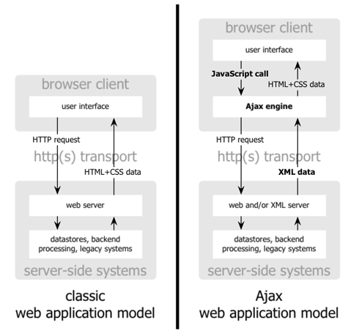

Slide 8
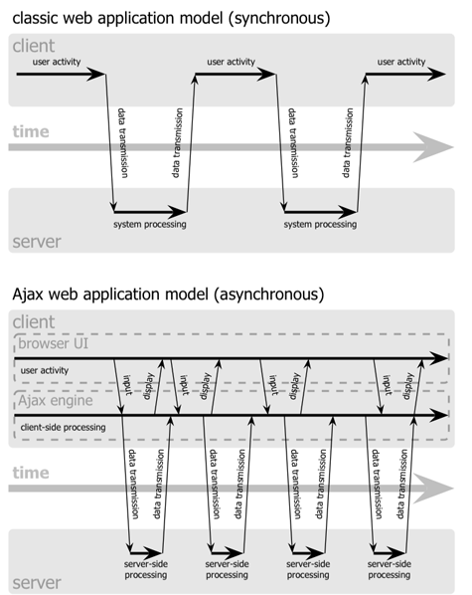

Slide 9
Ajax Engine
An Ajax application places an intermediary between the user and the server called Ajax Engine (also known as JavaScript part of a web page).
It seems like adding a layer to the application would make it less responsive, but the opposite is true.
Instead of loading a webpage, at the start of the session, the browser loads an Ajax engine — written in JavaScript and usually tucked away in a hidden frame.
This engine is responsible for both rendering the interface the user sees and communicating with the server on the user’s behalf.
The Ajax engine allows the user’s interaction with the application to happen asynchronously — independent of communication with the server. So the user is never staring at a blank browser window and an hourglass icon, waiting around for the server to do something.

Slide 10
How Ajax works?
Every user action that normally would generate an HTTP request takes the form of a JavaScript call to the Ajax Engine instead.
Any response to a user action that doesn’t require a trip back to the server — such as simple data validation, editing data in memory, and even some navigation — the engine handles on its own.
If the engine needs something from the server in order to respond — if it’s submitting data for processing, loading additional interface code, or retrieving new data — the engine makes those requests asynchronously, usually using XML, without stalling a user’s interaction with the application.

Slide 11
Underlying technologies
JavaScript
  Loosely typed scripting language
  JavaScript function is called when an event in a page occurs
  Glue for the whole AJAX operation
DOM
  API for accessing and manipulating structured documents
  Represents the structure of XML and HTML documents
CSS
  Allows for a clear separation of the presentation style from the content and may be changed programmatically by JavaScript
XMLHttpRequest
  JavaScript object that performs asynchronous interaction with the server

Slide 12
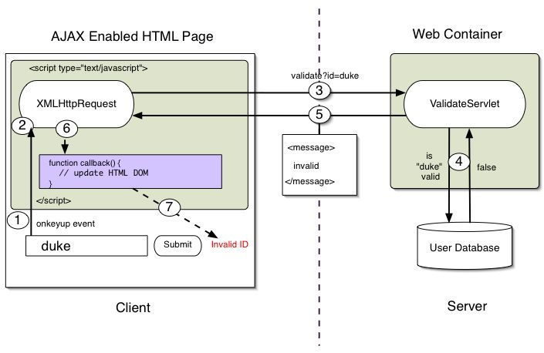
Steps of Ajax Operation

Slide 13
Steps of Ajax Operation
A client event occurs
An XMLHttpRequest object is created
The XMLHttpRequest object is configured
The XMLHttpRequest object makes an async. Request
The ValidateServlet returns an XML document containing the result
The XMLHttpRequest object calls the callback() function and processes the result
The HTML DOM is updated

Slide 14
Starting from the browser…
Your browser must allow JavaScript, or Ajax won’t work
  Otherwise, there’s nothing special required of the browser
Your browser has some some way of providing data to the server—usually from an HTML form
JavaScript has to handle events from the form, create an XMLHttpRequest object, and send it (via HTTP) to the server
  Nothing special is required of the server—every server can handle HTTP requests
  Despite the name, the XMLHttpRequest object does not require XML

Slide 15
The XMLHttpRequest object
JavaScript has to create an XMLHttpRequest object
For historical reasons, there are three ways of doing this
  For most browsers, just do
  var request = new XMLHttpRequest();
  For some versions of Internet Explorer, do
  var request = new ActiveXObject("Microsoft.XMLHTTP");
  For other versions of Internet Explorer, do
  var request = new ActiveXObject("Msxml2.XMLHTTP");
The next slide shows a JavaScript function for choosing the right way to create an XMLHttpRequest object

Slide 16
Getting the XMLHttpRequest object
function getXMLHttpRequest {
var request = false;
try { request = new XMLHttpRequest(); }
catch(err1) {
try { var request = new ActiveXObject("Microsoft.XMLHTTP"); }
catch(err2) {
try { var request = new ActiveXObject("Msxml2.XMLHTTP"); }
catch(err3) {
request = false;
}
}
}
return request;
}

Slide 17
Preparing the XMLHttpRequest object
Once you have an XMLHttpRequest object, you have to prepare it with the open method
request.open(method, URL, asynchronous)
  The method is usually 'GET' or 'POST'
  The URL is where you are sending the data
    If using a 'GET', data is appended to the URL
    If using a 'POST', data is added in a later step
  If asynchronous is true, the browser does not wait for a response (this is what you usually want)
request.open(method, URL)
  As above, with asynchronous defaulting to true

Slide 18
Sending the XMLHttpRequest object
Once the XMLHttpRequest object has been prepared, you have to send it
request.send(null);
  This is the version you use with a GET request
request.send(content);
  This is the version you use with a POST request
  The content has the same syntax as the suffix to a GET request
  POST requests are used less frequently than GET requests
  Example:
  request.send('var1=' + value1 + '&var2=' + value2);

Slide 19
Some more methods of XMLHttpRequest object
abort()
  Terminates current request
getAllResponseHeaders()
  Returns headers (labels + values) as a string
getResponseHeader(“header”)
  Returns value of a given header
setRequestHeader(“label”,”value”)
  Sets Request Headers before sending

Slide 20
XMLHttpRequest Properties
onreadystatechange
  Set with an JavaScript event handler that fires at each state change
readyState – current status of request
  0 = uninitialized
  1 = loading
  2 = loaded
  3 = interactive (some data has been returned)
  4 = complete
status
  HTTP Status returned from server: 200 = OK
responseText
  String version of data returned from the server
responseXML
  XML document of data returned from the server
statusText
  Status text returned from server

Slide 21
On the server side
The server gets a completely standard HTTP request
In a servlet, this would go to a doGet or doPost method
The response is a completely standard HTTP response
Instead of returning a complete HTML page as a response, the server returns an arbitrary text string (possibly XML, possibly something else)

Slide 22
Getting the response
Ajax uses asynchronous calls—you don’t wait for the response
Instead, you have to handle an event
  request.onreadystatechange = someFunction;
    This is a function assignment, not a function call
    When the function is called, it will be called with no parameters
  function someFunction() {
  if(request.readyState == 4){
  var response = request.responseText;
  // Do something with the response
  }
  }
To be safe, set up the handler before you call the send function

Slide 23
Using response data
When you specify the callback function,
request.onreadystatechange = someFunction;
you can’t specify arguments
Two solutions:
  Your function can use the request object as a global variable
    This is a very bad idea if you have multiple simultaneous requests
  You can assign an anonymous function:
  request.onreadystatechange = function() { someFunction(request); }
    Here the anonymous function calls your someFunction with the request object as an argument.

Slide 24
Displaying the response
http_request.onreadystatechange =
function() { alertContents(http_request); }; http_request.open('GET', url, true);
http_request.send(null);
function alertContents(http_request) {
if (http_request.readyState == 4) { /* 4 means got the response */
if (http_request.status == 200) {
alert(http_request.responseText);
} else {
alert('There was a problem with the request.');
}
}
}

Slide 25
The readyState property
The readyState property defines the current state of the XMLHttpRequest object.
Here are the possible values for the readyState property:
  readyState=0 after you have created the XMLHttpRequest object, but before you have called the open() method.
  readyState=1 after you have called the open() method, but before you have called send().
  readyState=2 after you have called send().
  readyState=3 after the browser has established a communication with the server, but before the server has completed the response.
  readyState=4 after the request has been completed, and the response data have been completely received from the server.
Not all browsers use all states
Usually you are only interested in state 4

Slide 26
Doing it with XML
Here’s an XML file named test.xml:
<?xml version="1.0" ?>
<root> I'm a test. </root>
Then in alertContents() from the previous slide, we need to replace the line
alert(http_request.responseText);
with:
var xmldoc = http_request.responseXML;
var root_node =
xmldoc.getElementsByTagName('root').item(0);
alert(root_node.firstChild.data);
From: http://developer.mozilla.org/en/docs/AJAX:Getting_Started

Slide 27
XML notes
The XML response object supports very complete XML DOM processing
The response header must include:
  Content-Type: application/xml
  or IE will throw an “Object expected” JavaScript error
  Cache-Control: no-cache
  or the response will be cached and the request will never be resubmitted
For some browsers you may need to do
request.overrideMimeType('text/xml');
  In Firefox, this will give an error if the response isn’t valid XML

Slide 28
innerHTML
innerHTML is a non-W3C DOM property that gets or sets the text between start and end tags of an HTML element
  When the innerHTML property is set, the given string completely replaces the existing content of the object
  If the string contains HTML tags, the string is parsed and formatted as it is placed into the document
Syntax:
var markup = element.innerHTML;
element.innerHTML = markup;
Example:
document.getElementById(someId).innerHTML = response;

Slide 29
Use Cases of Ajax
Real-time form data validation
Autocompletion
Load on demand
Sophisticated UI controls and effects
Refreshing data and server push
Partial submit

Slide 30
Pros and Cons
Pros
  Most viable RIA technology so far
  Tremendous industry momentum
  Several toolkits and frameworks are emerging
  No need to download code & no plug-in required
Cons
  Still browser incompatibility
  JavaScript is hard to maintain and debug
  May break expected behavior of browser’s Back Button

Slide 31
References
http://www.xul.fr/web-2.0.html
http://www.adaptivepath.com/ideas/essays/archives/000385.php
http://www.w3schools.com/ajax/ajax_xmlhttprequest.asp
http://www.xml.com/pub/a/2005/02/09/xml-http-request.html
http://developer.mozilla.org/en/docs/AJAX:Getting_Started
https://developer.mozilla.org/en/XMLHttpRequest
SAMS Teach Yourself Ajax in 10 Minutes, Phil Ballard, p. 85
JavaScript & AJAX, 6th Edition, Tom Negrino and Dori Smith, ch.15
Ajax Basic by Sang Shin Sang Shin (Java Technology Architect), Sun Microsystems, Inc. Sun Microsystems, Inc. [sang.shin@sun.com], www.javapassion.com

